Slide 1

What’s New With .NET MAUI
Maddy Leger
Program Manager, .NET MAUI
Baton Rouge .NET User Group
@maddyleger1 | maddy@microsoft.com

Slide 2



.NET
Your platform for building anything
Desktop
Web
Cloud
Mobile
Gaming
IoT
AI

Slide 3
Native performance
ARM BINARY
IL + JIT
.NET
.NET
AOT
.APP
Compile and Link
.APK
C#
C#
Runs natively
Runs natively
Bindings
Bindings
.NET for iOS does full Ahead Of Time (AOT) compilation to produce an ARM binary for Apple’s App Store.
.NET for Android takes advantage of Just In Time (JIT) compilation on the Android device.

Slide 4












Native API Access

Slide 5

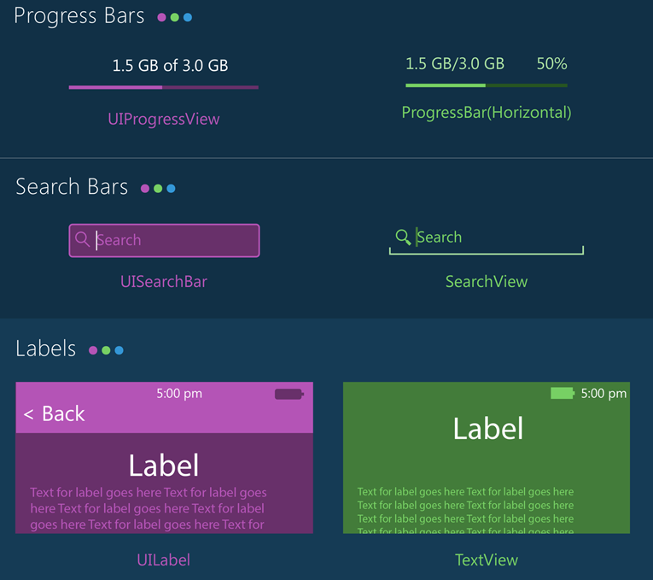
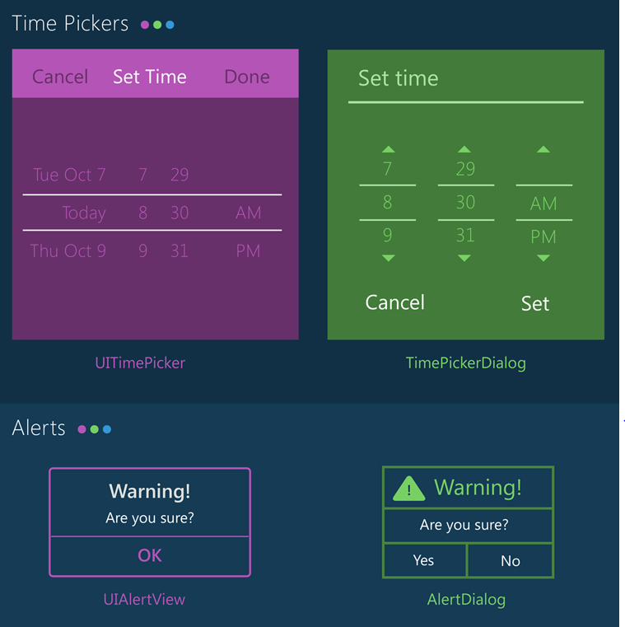
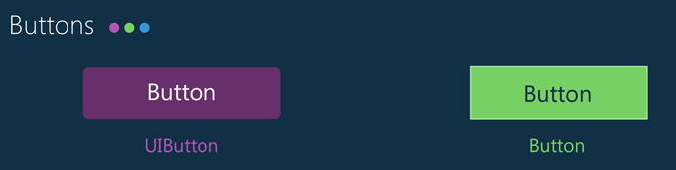
Native UI

Slide 6




.NET Multi-platform App UI
.NET 6
Cross-platform, native UI
Single project system, single codebase
Deploy to multiple devices, mobile & desktop
General availability in .NET 6, Fall 2021
.NET MAUI
WinUI
Mac Catalyst
iOS
Android
macOS
iOS
github.com/dotnet/maui

Slide 7
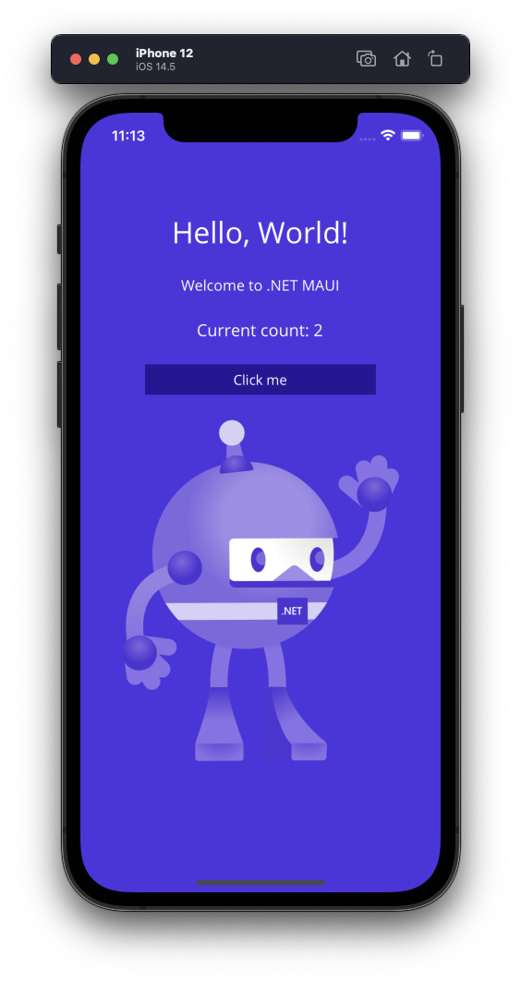
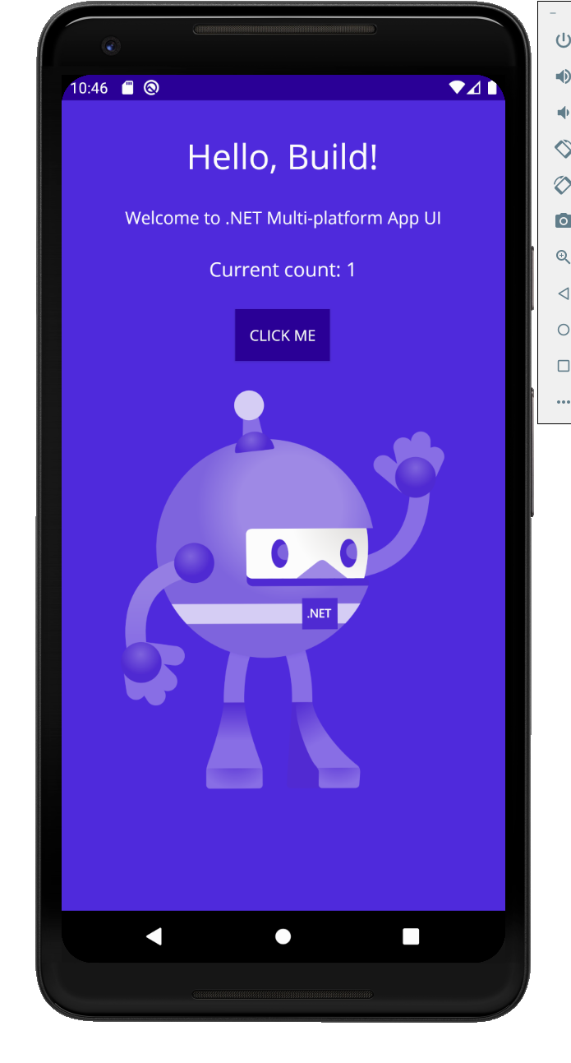
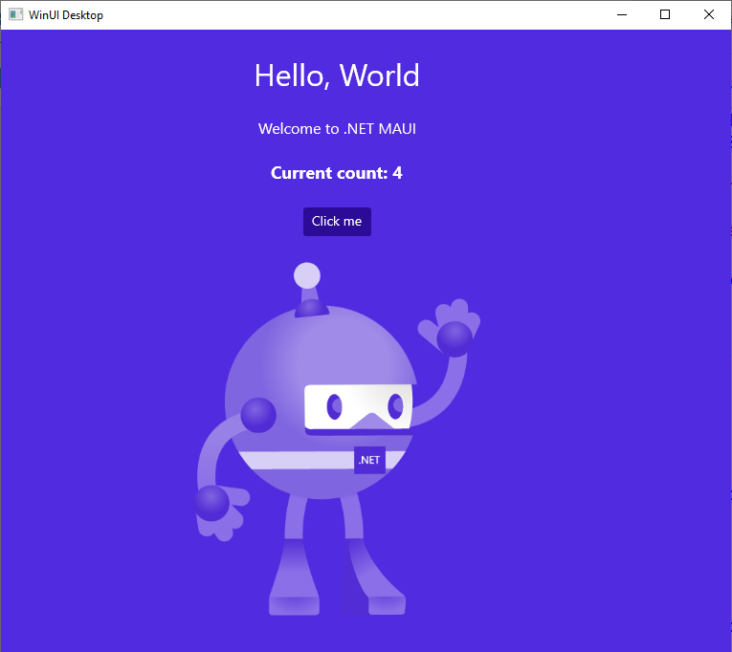
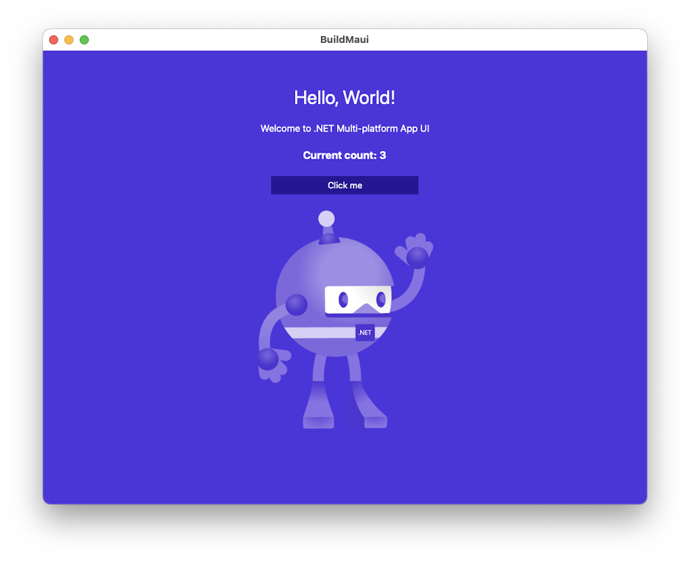
.NET MAUI is the most productive way to create native, performant Android, iOS, macOS, and Windows apps, all from a single codebase.

Slide 8




Productive
Hot Reloading for XAML, C#, Razor, CSS, and more
Develop for iOS and Android from Windows
Powerful Intellisense and code editing tools

Slide 9
.NET MAUI is part of .NET 6
Ships GA Nov 2021
Install via dotnet CLI or Visual Studio installers
Includes templates, Android, iOS, and Mac (Catalyst) SDKs
Develop with Visual Studio 2022 and Visual Studio for Mac 2022
Integrates seamlessly with other .NET platforms/architectures

Slide 10
Blazor hybrid desktop apps
Blazor
Reuse UI components across native and web
Built on top of .NET Multi-platform App UI
Native app container & embedded controls
General availability in .NET 6
Can use native app
container & controls
.NET Multi-platform App UI
macOS

Slide 11




























Built on mature, proven tech
Xamarin
Loved by developers, trusted by enterprise

Slide 12
Xamarin
Loved by developers, trusted by enterprise

Slide 13
Demo
Taking a tour of your first .NET MAUI app

Slide 14
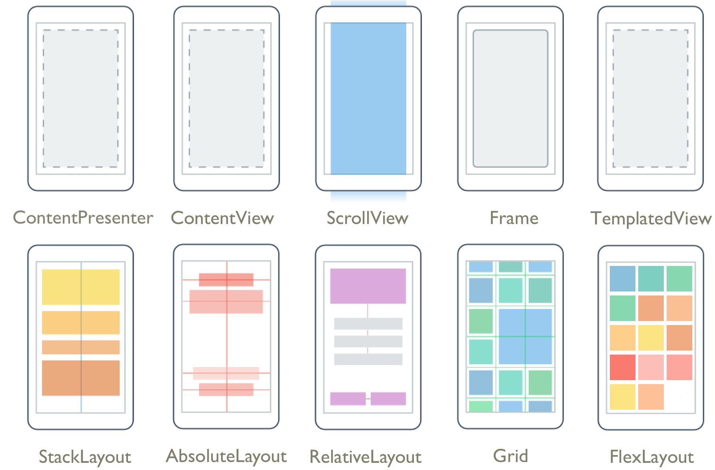
What’s included
✓ 50+ Pages, layouts, and controls
(Build from C# or XAML)
✓ Two-way data binding
✓ Navigation with Shell
✓ Visual State Manager
✓ Animation and Drawing APIs
✓ 1000s of control customizations

Slide 15
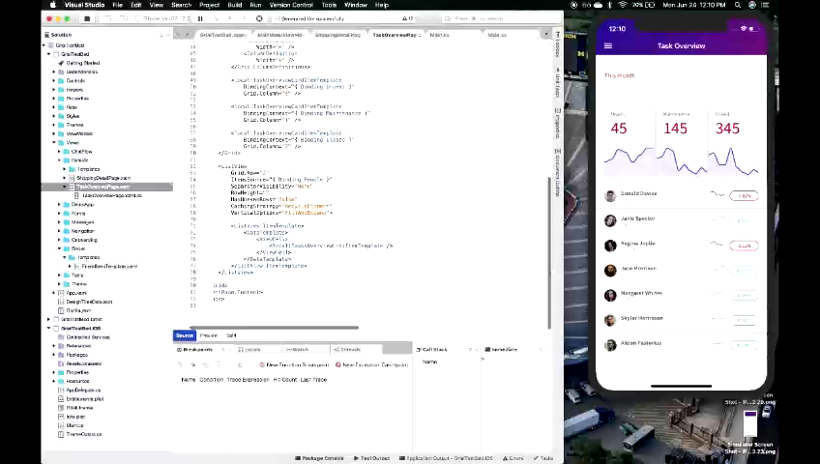
XAML Hot Reload for .NET MAUI
No code changes needed
Interact with your real data on emulators, simulators, or devices
Intelligent and resilient
Works with custom controls, third party libraries, and more!

Slide 16
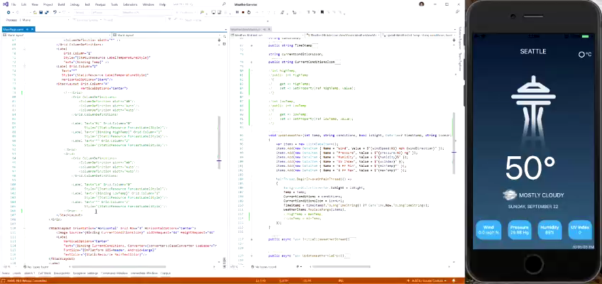
.NET MAUI Hot Restart
Fast rebuild and redeploy of your application
Debug on your iPhone directly from your PC
Works great with Hot Reload!

Slide 17
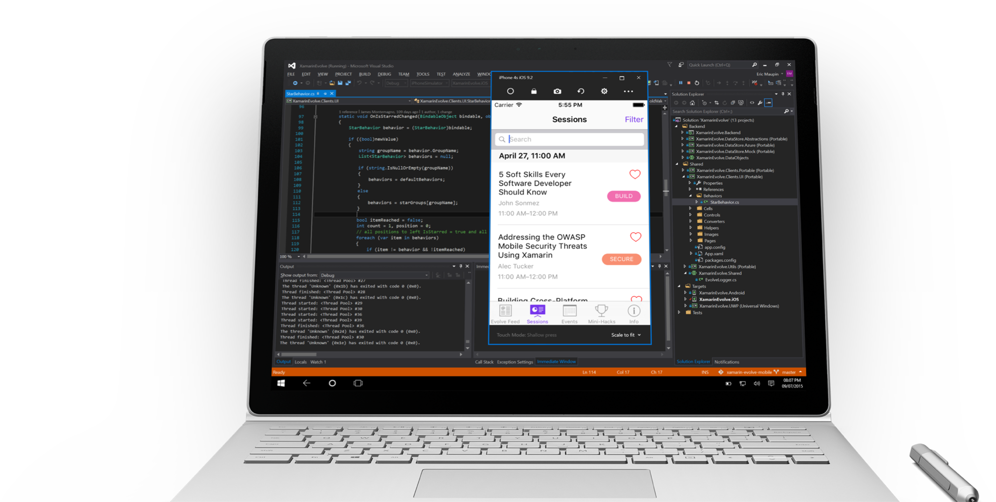
Visual Studio iOS Simulator Remoting
Multi-Touch Enabled
Pressure Sensitive
Super Fast
Rotate, screenshots, location changes
Never leave VS

Slide 18
Performant
Rearchitected handlers for faster layout rendering
Faster app startup
Better profiling tools

Slide 19
Single Codebase
Single .NET 6 project holds code for all platforms
Images, Fonts, Raw assets, etc. all shared
Single application point of entry
Simplified binding of native libraries

Slide 20
Demo
A deeper dive into .NET MAUI’s capabilities

Slide 21
.NET 6 Preview 5 6 out now!
TODAY!!!!
VS 2022 Preview 2 out now!
Try out .NET MAUI today!
Try it with Visual Studio 2022 (free in preview!)
devblogs.microsoft.com/dotnet/announcing-net-maui-preview-4/

Slide 22
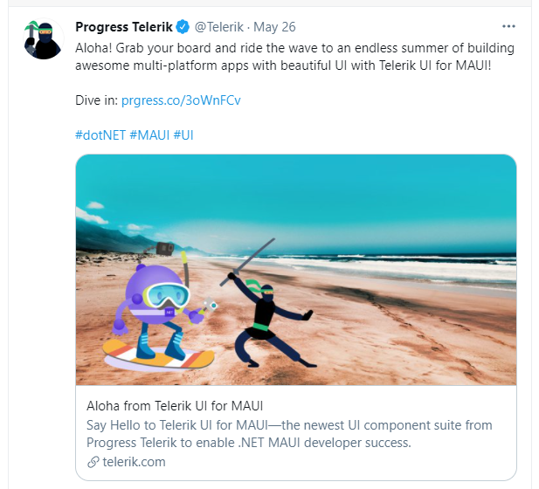
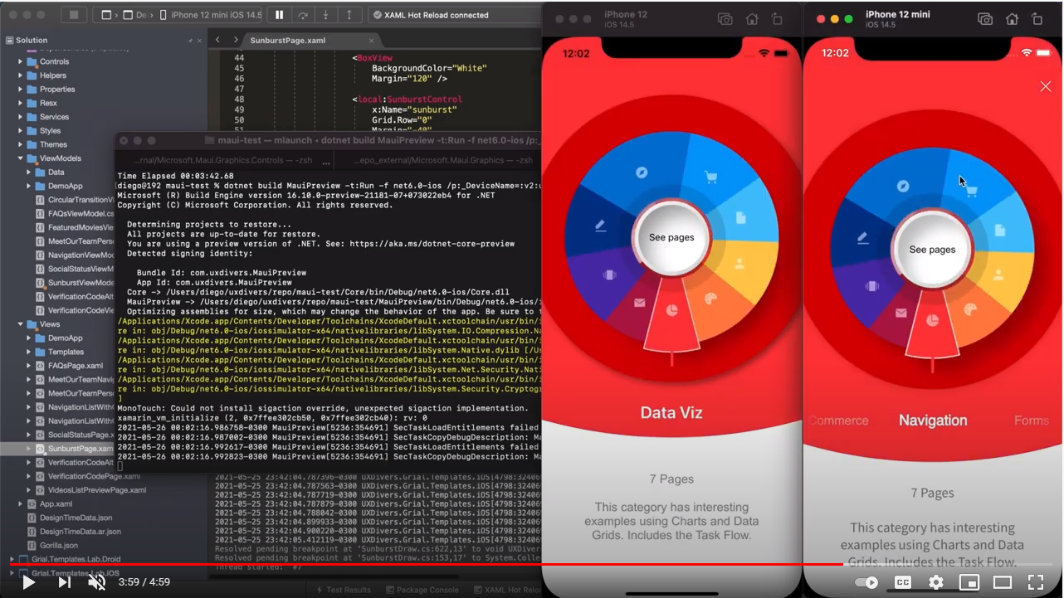
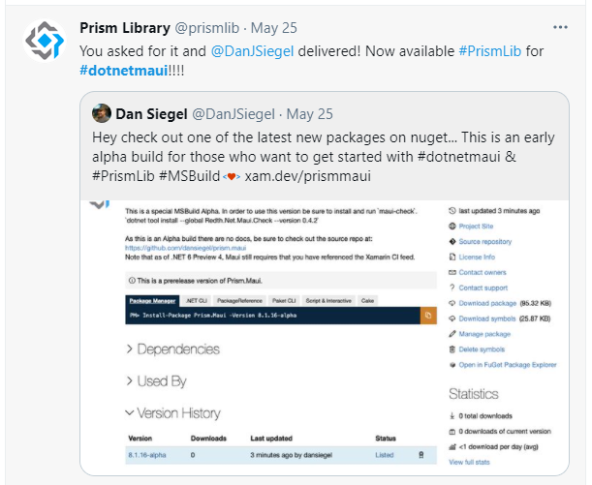
Ecosystem Highlights

Slide 23
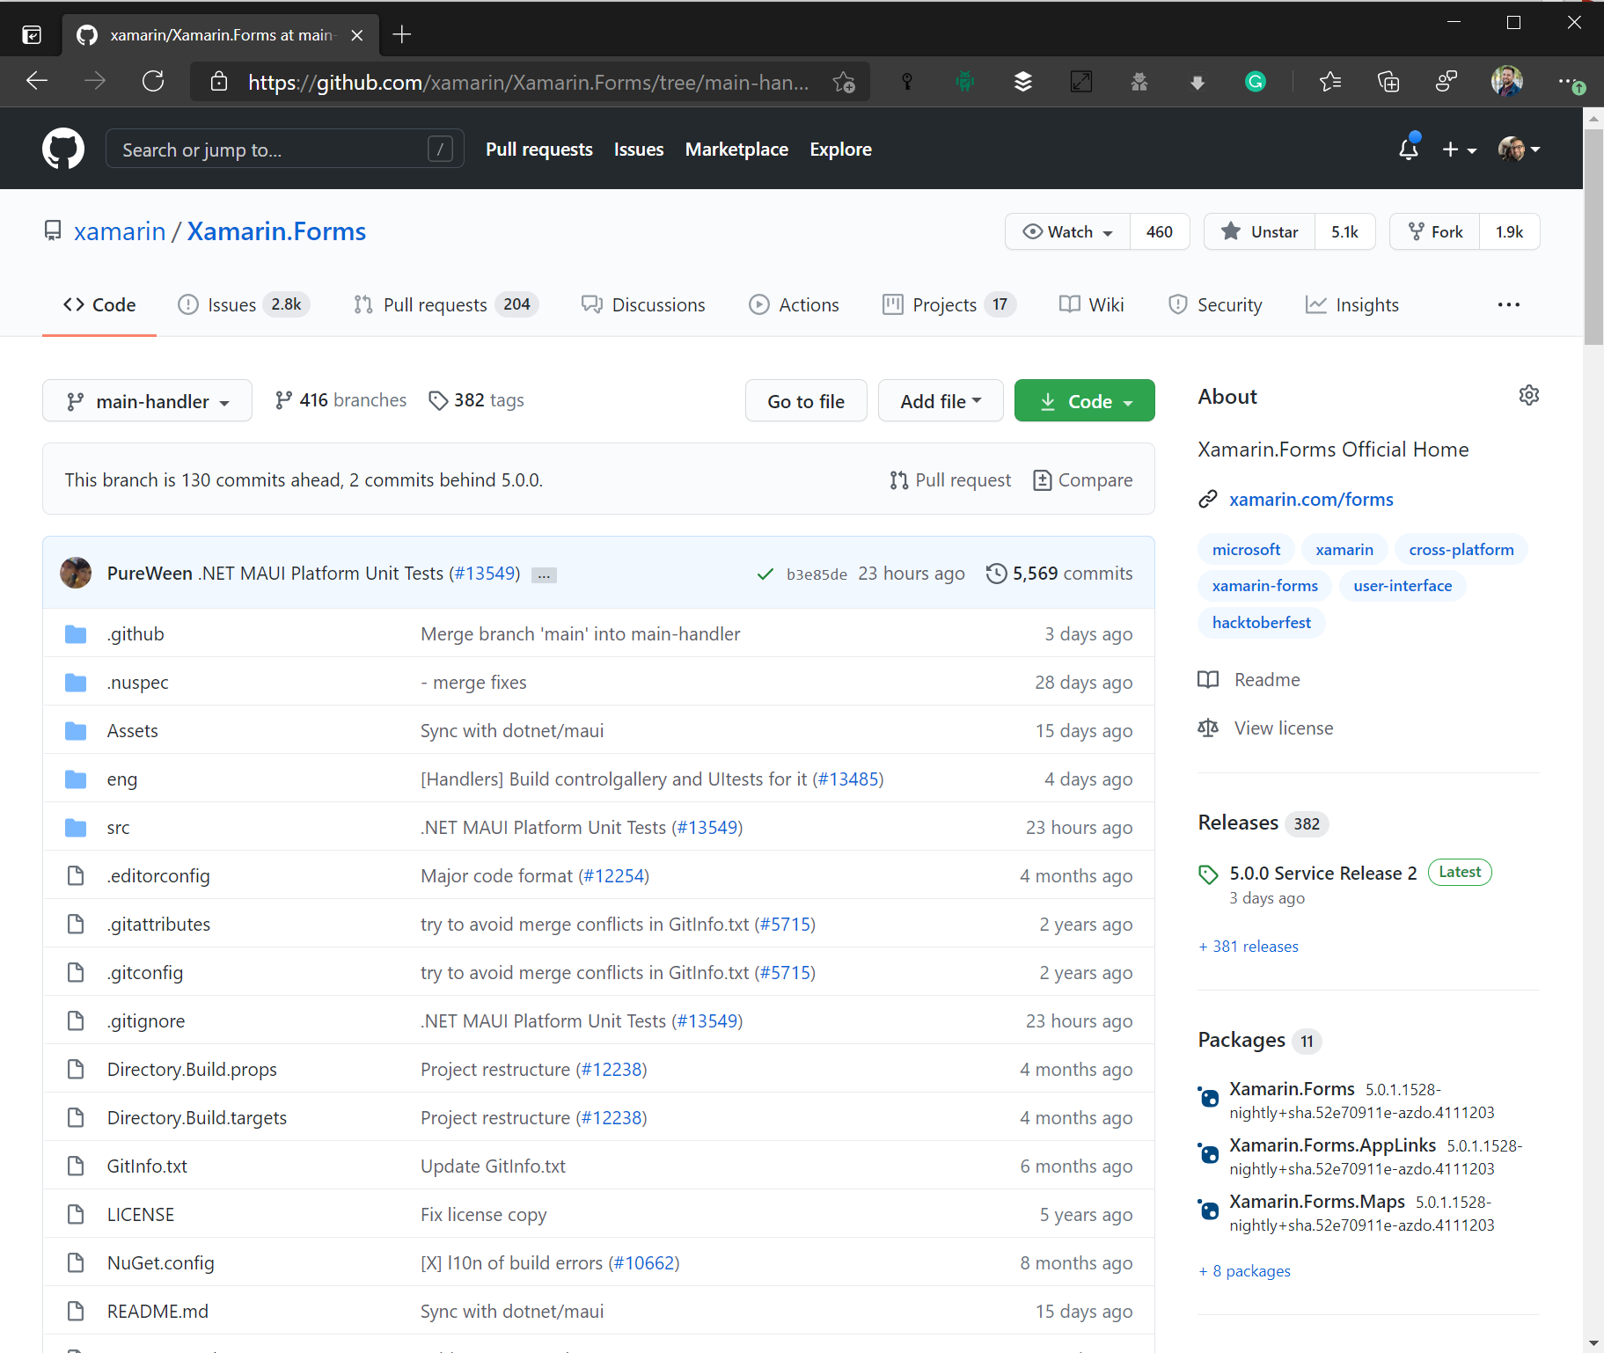
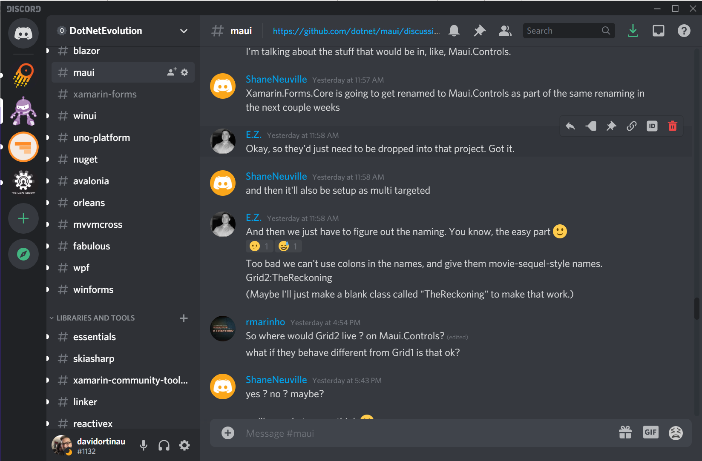
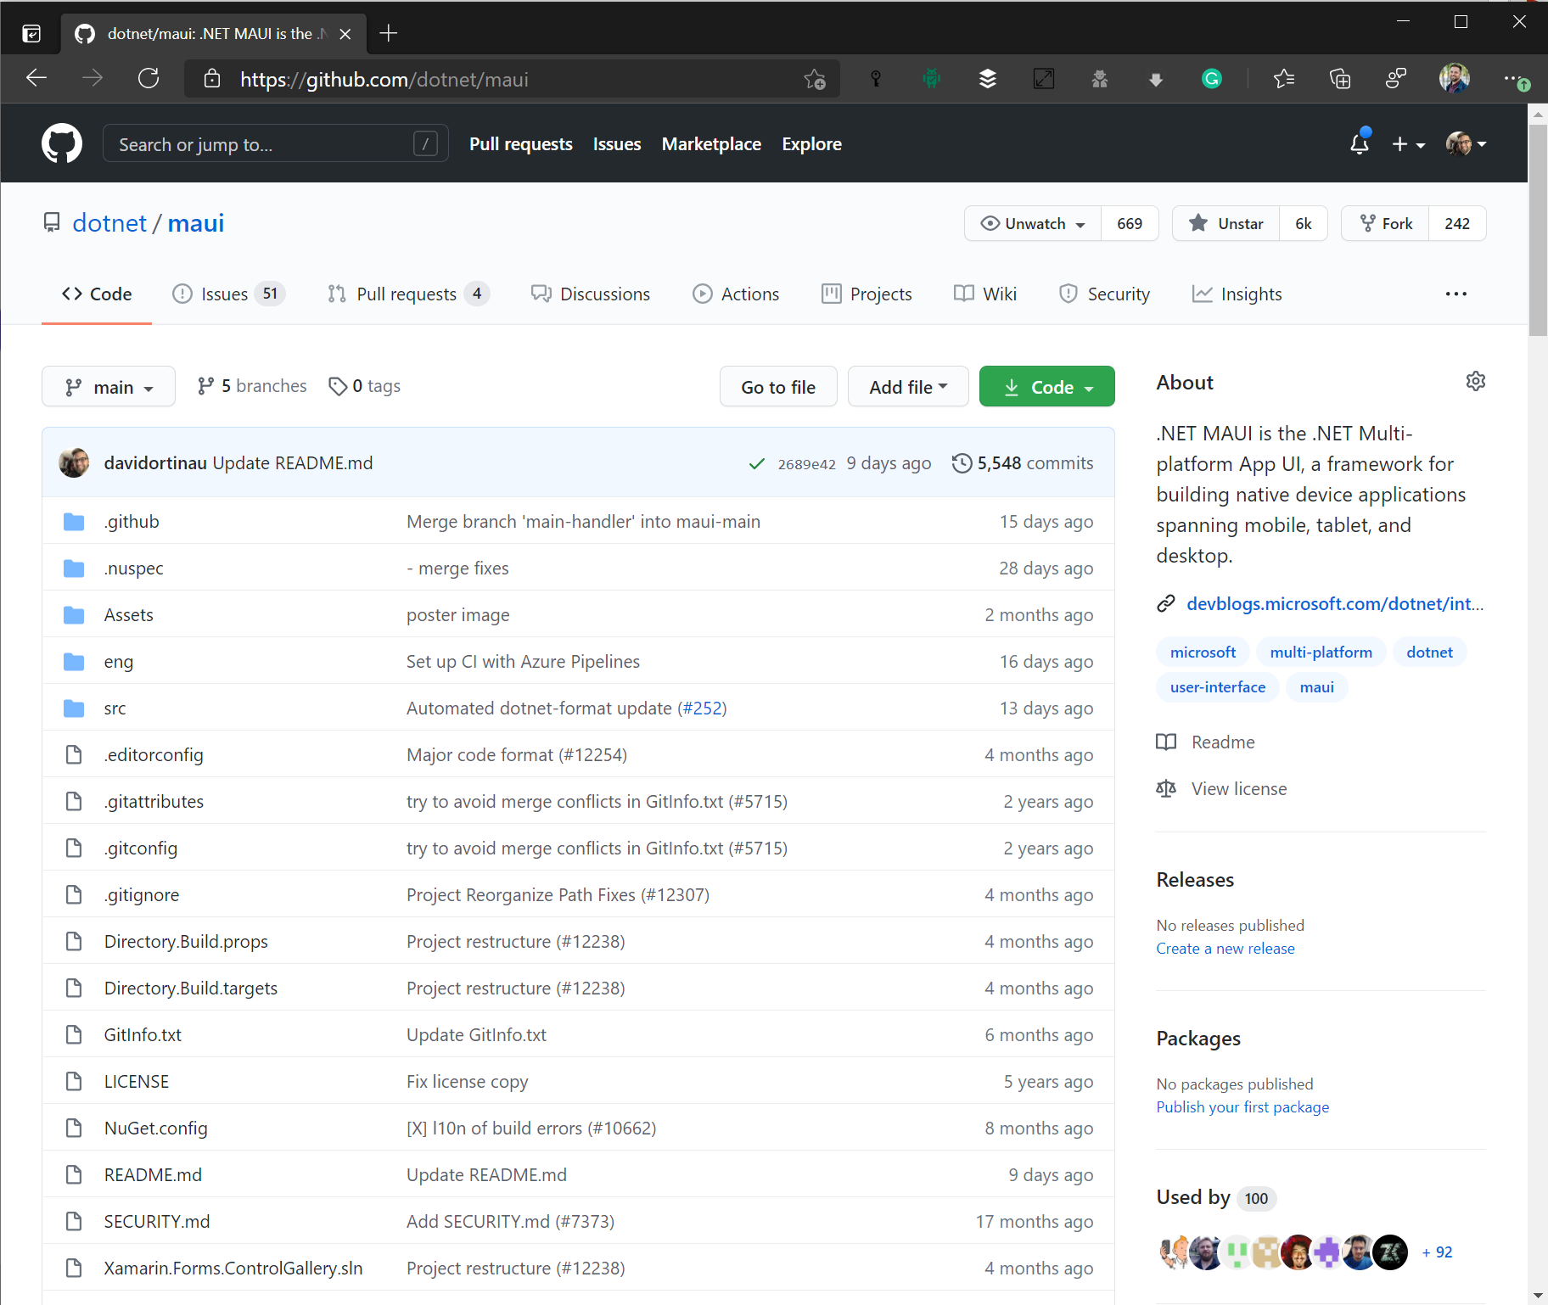
Where is this happening?
https://aka.ms/discord-maui
https://github.com/dotnet/maui

Slide 24

.NET Community Standup
https://live.dot.net
1st Thursday of the Month @ Noon PT / 3 ET
Community News
Contributions
.NET MAUI Status Report
Shenanigans!

Slide 25

Thanks for joining!
Maddy Leger
@maddyleger1
maddy@microsoft.com

Slide 26







Slide 27








Slide 28









Slide 29









Slide 30





